Slide 1

Case study: Breast cancer
Hypothesis: all variables are equally important to help distinguish the presence of breast cancer
Objectives:
Detection of breast cancer
identifying important features helps rapidly detect breast cancer

Slide 2
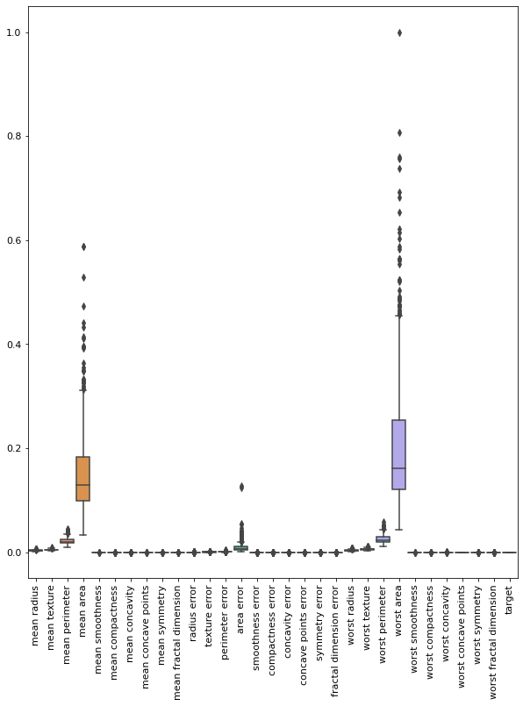
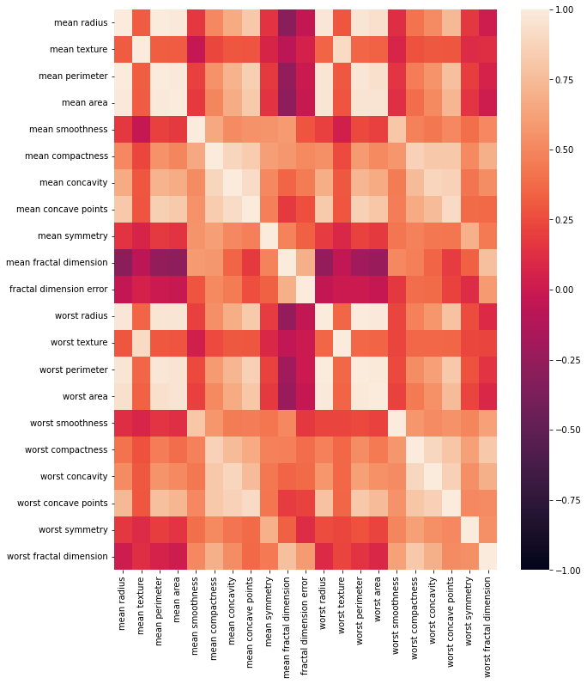
Exploratory analysis of breast cancer data: Finding important variables to classify Begnin [1] : non-breast cancer from Maglinent [0] : breast cancer
Correlation heatmap between variables
Box plot for all variables
outliers

Slide 3
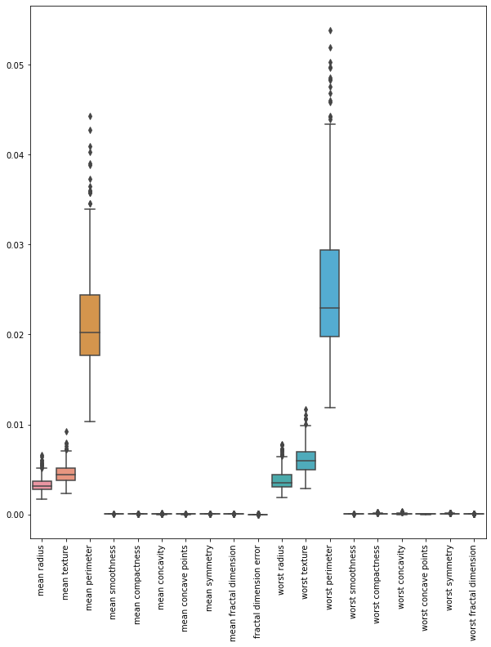
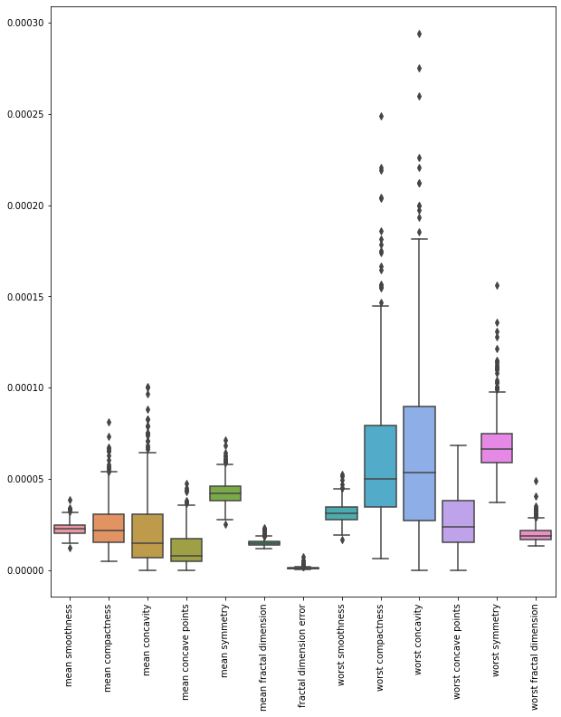
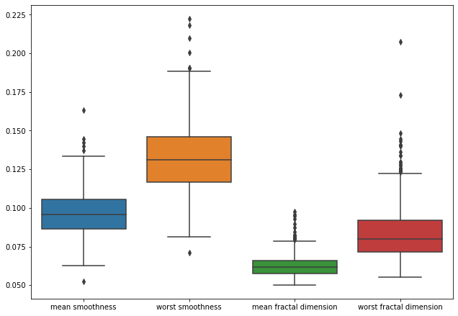
Detection of outliers

Slide 4
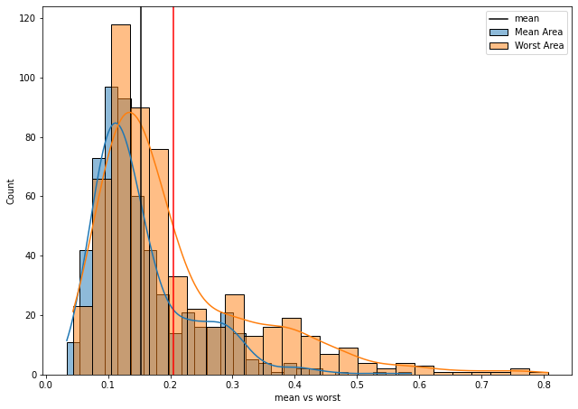
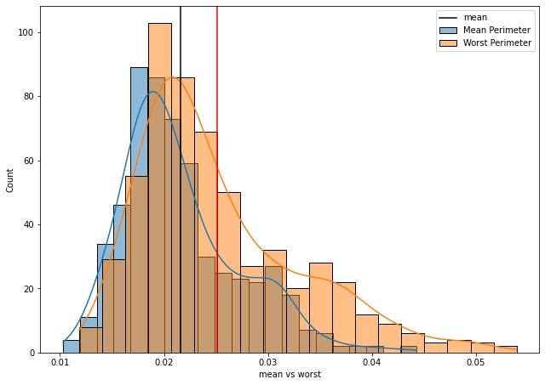
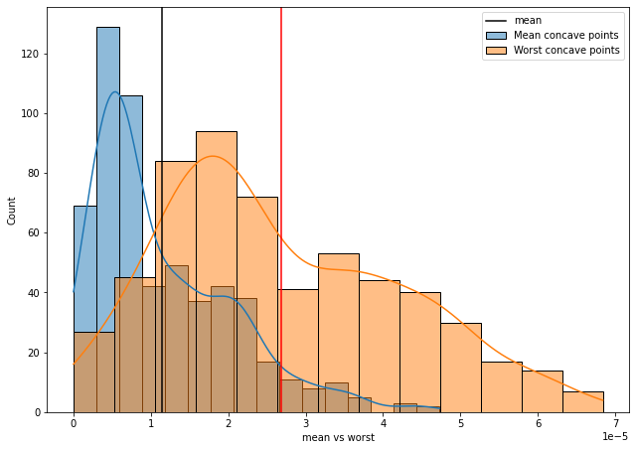
Observe important variables between mean and worst

Slide 5
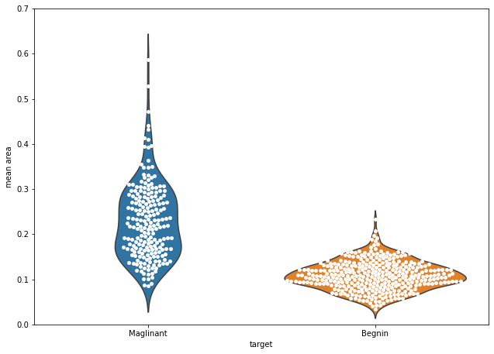
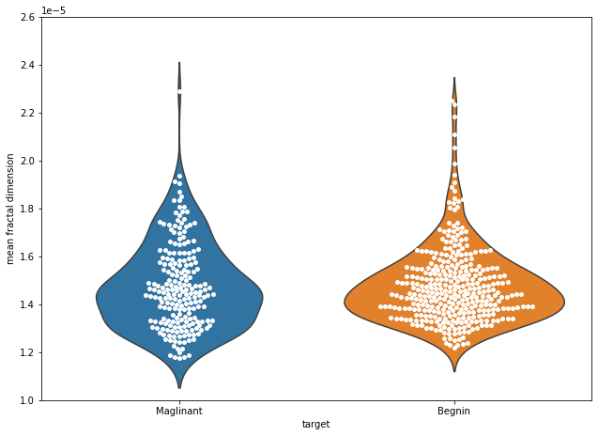
Observe the most important feature using violin and swamp distribution plot

Slide 6
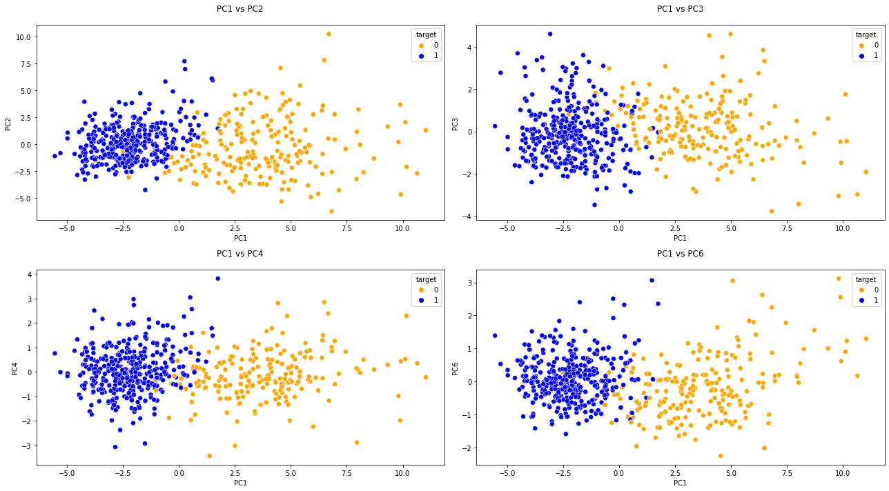
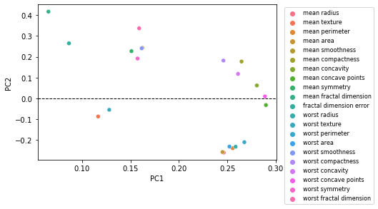
Classification of breast cancer patients (1) from non-breast cancer (0) using Principal component analysis (PCA)
PCA scores
Variables loading scores

Slide 7
Multivariate classification
Purpose: Build a model to classify patients having breast cancer from patients without cancerssification methods
Data: n = 568 patients
variables = 20
Training set: 397 patients
Test set: 171 patients
Tool: Python’s scikit-learn
Classification methods | Precision | Recall | F1 score | Overall Accuracy
Logistic regression | 0.82 | 1.0 | 0.9 | 0.87
LinearSVM | 0.92 | 0.98 | 0.95 | 0.94

